Slide 1
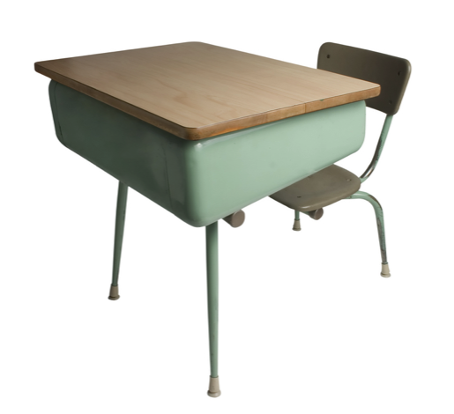
Ideal Tier-3 Inclusion Model
Zeshan Segal

Slide 2
Employment Background
The Disparity in the System
3, 6, & 12 Month Plan
Zeshan Segal

Slide 3
Employment Background
The Disparity in the System
3, 6, & 12 Month Plan
Zeshan Segal

Slide 4
2004
2005
2006
2007
2008
2013
2014
2015
2016
Dobie Middle School, Austin ISD
Youth Advisor
Council on At-Risk Youth (CARY)
National Audubon Society
Education Manager
Outdoor Education Center, Houston ISD
Environmental Educator
LEAP Now
India Trip Leader
Miller Elementary, Arlington ISD
6th Grade Geography, In-House Sub to Permanent Teacher
Texas State University- San Marcos
B.S. Geography
B.A. Anthropology
Zeshan Segal
Notes:
This role is a perfect fit for me. I know the school system, I know the issues teachers have, I can meet students where they are at, and have no problem meeting and relating to anyone. It is a special gift, and something I know will be of benefit to your organization.

Slide 5
Employment Background
The Disparity in the System
3, 6, & 12 Month Plan
Zeshan Segal
Notes:
The Disparity is clear. Punitive repercussions for low-income and special needs students is not the answer. It clearly does not work, and will continue to lead to inequality. This needs to be addressed from the national, state and district level.
State leaders, schools, and districts need to have an understanding of the wide range and severity of behavior and the related needs to help prevent these children from achieving academic success and contribute to their behavioral problems.

Slide 6

Special needs students are disproportionately suspended and expelled
Zeshan Segal
Notes:
When I was offered the interview, I spoke with Ms. Isenberg, and she let me know I was to present on what an ideal tier 3 inclusion would look like. So, I decided it would be necessary to take it to a bigger picture. The problem is that a disproportionate amount of special needs students are being suspended and expelled.
As an advocate for a lot of these students, my job has been to keep these EXACT types of students on campus working with students at a Tier 1 to Tier 3 level. We try and deal with the issues when they occur, and address the needs of the students directly. I work on replacing negative behaviors with positive character traits. Using a program called Aggression Replacement Training, or ART. Advocating to keep the students on campus, determining the behaviors and factors contributing to the issues at hand, and dealing with them directly.
Using families, the administration, counselors, and others, we work on the behavior intervention plan, and using social services, and Social Skills classes, we all help to reinforce positive behavior. One of the first steps is a need to have early intervention, and prevention as a solution to curbing students from reaching the 3rd Tier later on. So, my ideal model, would stop students from reaching this tier with early needs assessments. There is also a need to have a uniformed, evidenced based curriculum that is scaffolded.
The strategy is to implement region wide character and social skill education with the purpose of providing inclusive and universal Tier 1 strategies at an early age. All students should have mandatory Social Skills classes starting from Kindergarten onwards. Alternative therapies have also been proven to be successful. At my school, we have a service dog, Sugar. I can't tell you the number of times she has been involved with a student crisis at our school. Music therapy, environmental play therapy, art therapy all have value. Being progressive and finding strategies that benefit each individual student are other ways we can help a student that is struggling. We need to get to these students early on, work on these skills, and create a positive and understanding school.

Slide 7
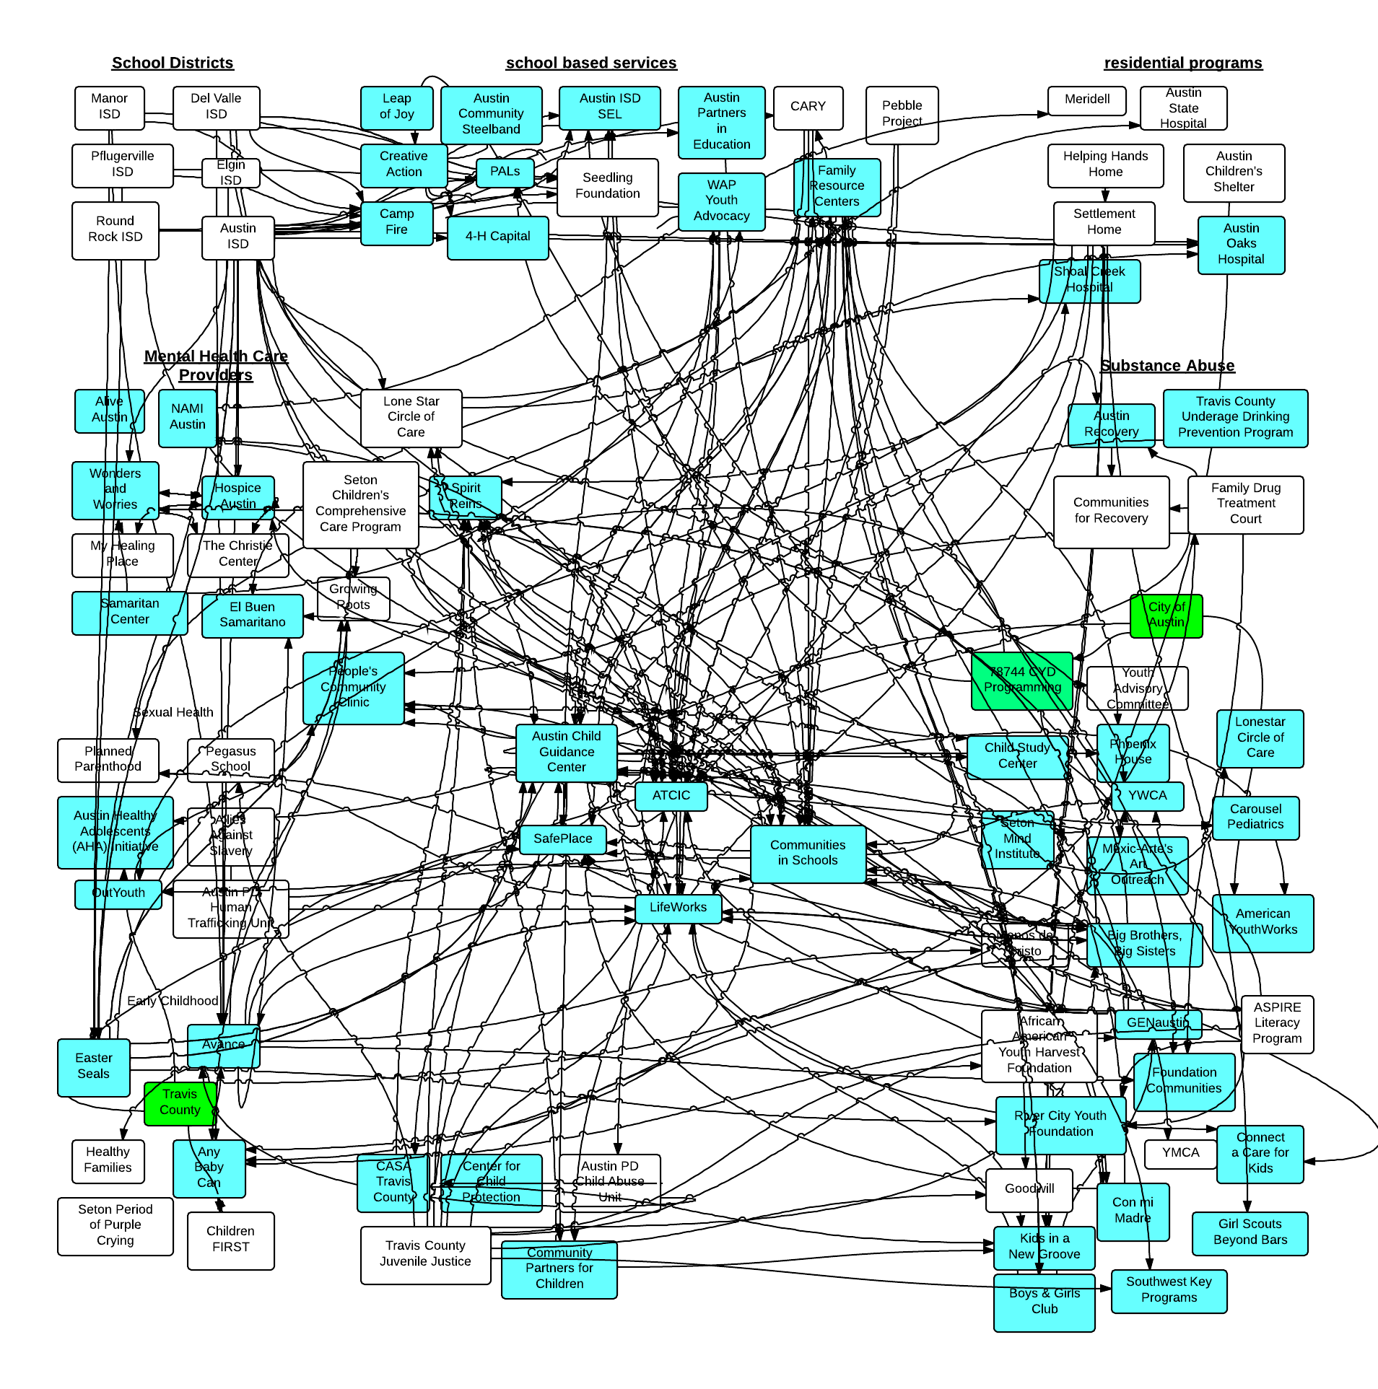
The referral process is highly
complex
Zeshan Segal
Notes:
You may not be able to see all the connections in this slide, but this is the referral system for school districts, school based services, and residential programs. The slide was created by Hannah Brown, and she presented on Adverse Childhood Experiences influencing problematic behavior, and how to address it.
How do we streamline this mess, and make it more efficient? What forms are being used at each school? Are they the same within the entire district? Can a student transfer from one school to the next, and expect the same social skills training? Aggression Replacement Training is at 11 schools in AISD. These students can transfer within the district, and can receive the same Cognitive Behavioral Training. Fidelity is Key.
I recommend ART because it is an evidenced based curriculum that is student focused and scaffolded. It has been shown to decrease serious discipline incidences, and works within the district.

Slide 8

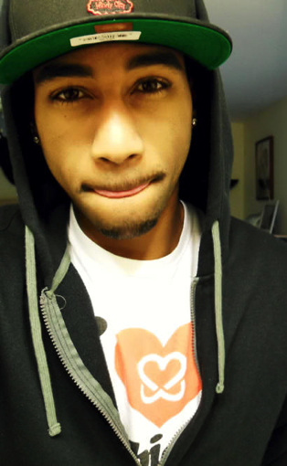

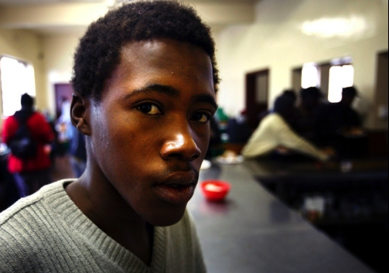
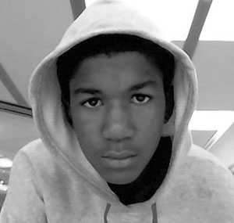


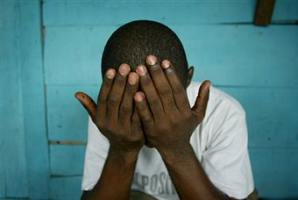



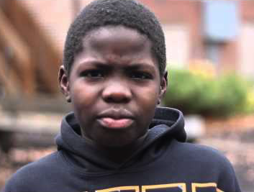
Black male students are
3X more likely
to be suspended or expelled
Zeshan Segal
Notes:
According to the US Department of Education Office for Civil Rights: Black students are suspended and expelled at a rate three times greater than white students. Students with disabilities are more than twice as likely to receive an out-of-school suspension (13%) than students without disabilities (6%). With the exception of Latino and Asian American students, more than one out of four boys of color with disabilities (served by IDEA) — and nearly one in five girls of color with disabilities — receives an out-of-school suspension. While black students represent 16% of student enrollment, they represent 27% of students referred to law enforcement and 31% of students subjected to a school-related arrest. In comparison, white students represent 51% of enrollment, 41% of students referred to law enforcement, and 39% of those arrested. Students with disabilities (served by IDEA) represent a quarter of students arrested and referred to law enforcement, even though they are only 12% of the overall student population.
Clearly Zero Tolerance and School Discipline need to be revaluated, and need to be addressed at the campus level using Positive Behavior Intervention Strategies and Support. There needs to be an initial review of the policies and programs that are creating positive, progressive change using PBIS strategies nationally, and at the state level.
We know that these types of evidenced based programs, like ART, The Tough Kid Tool Box, Solid Roots, are effective in creating positive change. So from the National, to the state, to the region, to the district, to the campus to admin, to the teachers, students and families.... there needs to be absolute buy-in to creating positive change on a campus.

Slide 9
factors
ongoing
income
poor
utility
potential
inequality
national
enormous
afford
Unequal access to resources
incentives
civic
disparity
race
reforms
creates
opportunity
jobs
living
distribution
comparisions
differences
polarization
function
amount
groups
economic
Zeshan Segal
Notes:
We are able to CLEARLY identify these students. The data shows us exactly who they are. How do we close the inequality that exists in sending Special Needs students down the school to prison pipeline? A program that is focused on prevention is the answer. Getting ahead of the problem.
We do this thru advocacy for our clients. Working with the administration, teachers, students and families to address the issues early on at a campus level. We develop and work on positive character traits, and crisis response. Home Visits, Service Learning Projects, and parent empowerment classes all help to encourage a positive and supportive environment to encourage success in this demographic. Programs such as ART have shown a clear reduction in serious behavioral incidences on and off campus.

Slide 10

Missing
Buy-In
Zeshan Segal
Notes:
There needs to be complete, district wide cultural understanding and competency. Reinforced by cultural awareness and SEL trainings. The district, along with the administration, teachers and students at these schools must buy-in to create a protective environment for this vulnerable population. We need to create a climate of understanding that all students deserve the right to equal and free education.

Slide 11

al
M s ig m nt
i
n
e
Zeshan Segal
Notes:
The next step, I envision, is longitudinally aligning the language being used. What's the language being used on campus? Is it vertically aligned across schools within the district? We need to have elementary schools and secondary schools using consistent vocabulary that is scaffolded.
Along with buy-in, parents and schools need to talk about success of the students. A trajectory of success, and plans for establishing a successful future need to be planned early on.

Slide 12

Family
Barriers
Zeshan Segal
Notes:
Family Engagement is an integral part of making this change. We need to have accountable tracking of school/parent communication. This is a symbiotic relationship. Both sides need to be active participants. A lot of these families need coordinated care. The family, social services, and the school need to be in constant contact.
Also, the learning process is reinforced at home. We need to actively involve parents thru coordinated care services, schools as community centers, outreach education, parents need to be strongly involved at school and community levels. There also needs to be consistent communication between the schools and families regarding their child. There is a direct correlation between student performance and family engagement. According to Rhoda Becher's extensive review of parent education literature... these Effects include: significantly improved language skills, test performance, and school behavior, as well as important effects on the general educational process.
Student performance decreases with less parental involvement. This along with other barriers all help in creating negative traits in these students. Some of the biggest barriers I deal with include transportation, child care, incarcerated family members, substance abuse, immigration status, the fear of institutionalization, the stigma of being labeled a special needs student, and poverty and mobility. I know that at my school, mobility of our low-income students is around 30%. Currently, over 3 million students are on free or reduced lunch programs at schools in Texas. Creating a safety net to catch these students is critical. There are just so many social and environmental factors to consider when working with this population.

Slide 13
Communication
Streamlining
Prevention
Family Engagement
Student Focused
Coordinated Care
Longitudinal Alignment
Buy-In
Tier-3 Inclusion Methods
Zeshan Segal
Notes:
The way I would handle a campus as an Education Specialist for Region 13, would be to foster the established relationships, increase communication between schools and families, streamline the process, early intervention and prevention, and longitudinal alignment to create optimal operational efficiency. Thru family engagement, buy-in from the entire community, and having a clear process with clear expectations, we can create a inclusive program that supports and benefits all students.

Slide 14
Employment Background
The Disparity in the System
3, 6, & 12 Month Plan
Zeshan Segal
Notes:
So, if I were offered this position, this would be my ideal first year plan, starting with the first 3 months.

Slide 15

3
Foster & Establish Relationships
months
Evaluate Best Practices & Existing Programs
Assess Qualitative and Quantitative Metrics
Zeshan Segal
Notes:
Foster the relationships between schools, families, social services, and the district. Establish new relationships, as needed. Are new social services available? Let’s try and get them on campus for added support.
Evaluating the existing programs and vocabulary in place. We need to have elementary schools and secondary schools using consistent vocabulary that is scaffolded.
Review the policies and programs that are creating positive, progressive change using PBIS strategies nationally, and at the state level.
For example, according to a Center for Disease Control study: “Evaluation results indicated that schools participating in PBIS, compared to control schools, demonstrated lower rates of teacher-reported bullying. In addition, preliminary studies of social-emotional learning programs, such as Steps to Respect and Second Step, indicate some success in decreasing child reported bullying behaviors including homophobic teasing.“
What is working well? Assessing the qualitative data from the stakeholders on ideal service delivery models. You like using Solid Roots? Great. Let's get your district all vertically aligned. At the school, what are the most widely used and effective classroom management techniques? You start the campus where they are at, just as you would with any student.
Tracking any quantitative data from STAAR tests, grades, attendance, and behavior is also necessary. As well as, any other data that can be gathered from eCST. There needs to be an analysis of current IEPs, BIPs, ARDs, FBAs, etc.

Slide 16

6
Share Best Practices
months
Establish Longitudinal Alignment Within Districts
Zeshan Segal
Notes:
The next step would be to meet with Districts and Administration to share the best practices working within the district. There is no need to reinvent the wheel. As an Education Specialist, we have the flexibility to work with districts most effective procedures.
What's the language being used on campus? Is it vertically aligned across schools within the district? Longitudinal alignment is a key component to creating a successful inclusion program. Students should be able to move within the district, or ideally, the state, and have the same support services, and a basic understanding of the language being used. As the student grows, the language should continue to be the same, but scaffolded enough to grow along with the child.

Slide 17

12
Streamline the process
Establish in-district training & support
months
Introduce new technology
Re-evaluate effectiveness
Zeshan Segal
Notes:
Streamlining the process. What are things that will make this a more efficient and effective inclusion program?
District level trainings on cultural awareness and progressive Social and Emotional Learning. Having the general education teachers being able to ID and address issues early is critical.
Using innovative strategies and new technology. Kids are using cell phones in class. Why not embrace it, and use programs like Class Dojo or Social Express? Using integrated technology is an easy, and innovative way to track real-time data, determine procedures, and improve the efficiency of school based programs.
Embracing integrated technology is an innovative way for Region 13 to modernize the process and be the place where teachers and districts want to go for resources. Lastly, there needs to be a re-evaluation of changes made, and work to determine the effectiveness of these changes. Modifying as necessary.

Slide 18
Thank
You!
Zeshan Segal

